Slide 1
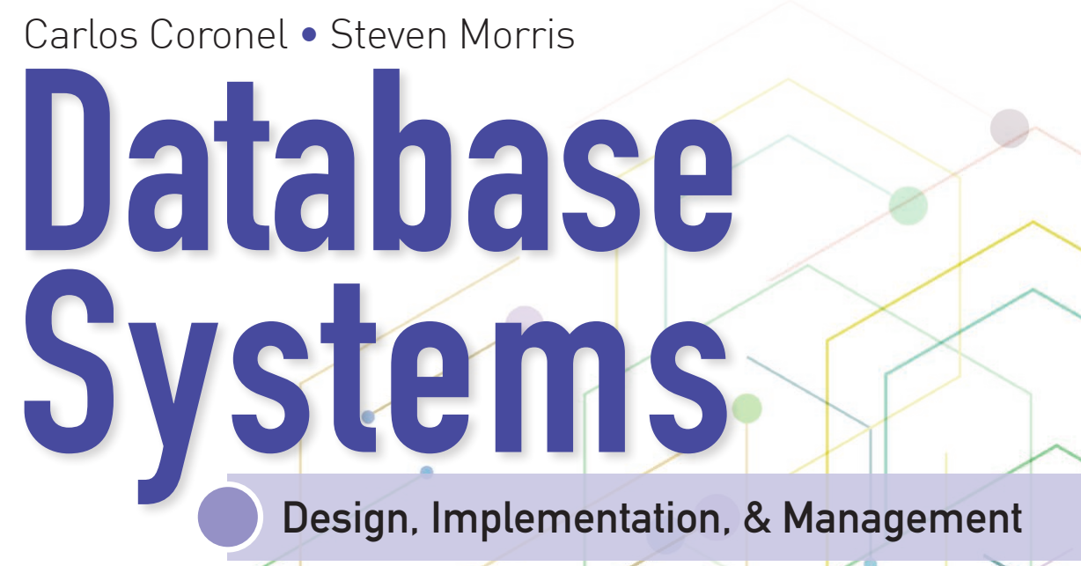
Learning Objectives
Define the difference between data and information
Describe what a database is, the various types of databases, and why they are valuable assets for decision making
Explain the importance of database design
Outline how modern databases evolved from file systems
Identify flaws in file system data management
Outline the main components of the database system
Describe the main functions of a database management system (DBMS)

Slide 2


National Economics University Faculty of Data Science & Artificial Intelligence
Database System Design, Implementation And Management Course – Advanced Data Modeling
Instructor: Duc Minh Vu (FDA – SLSCM Lab)
Email: minhvd [at] neu.edu.vn
12/19/2024
Database System Design, Implementation And Management
2

Slide 3
Learning Objectives
5-1 Describe the main extended entity relationship (EER) model constructs and how they are represented in ERDs and EERDs
5-2 Use entity clusters to represent multiple entities and relationships in an entity relationship diagram (ERD)
5-3 Describe the characteristics of good primary keys and how to select them
5-4 Apply flexible solutions for special data-modeling cases

Slide 4
5-1 The Extended Entity Relationship Model

Slide 5
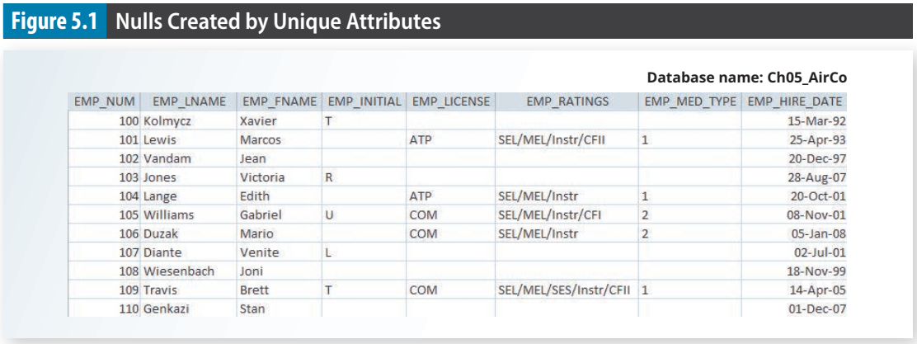
An EMPLOYEE table with many empty and null cells because of many types of employees (pilot, mechanic, account, etc.)

Slide 6
5-1 The Extended Entity Relationship Model
extended entity relationship model (EERM)
Enhanced entity relationship model; the result of adding more semantic constructs, such as entity supertypes, entity subtypes, and entity clustering, to the original entity relationship (ER) model.
EER diagram (EERD)
The entity relationship diagram resulting from the application of extended entity relationship concepts that provide additional semantic content in the ER model.

Slide 7
5-1a Entity Supertypes and Subtypes
Similar to base class and derived class in OOP.
entity supertype: generic entity type that contains the common characteristics of entity subtypes.
EMPLOYEE
entity subtype: the subtypes contain the unique characteristics of each entity.
PILOT, MECHANIC, ACCOUNTANT
Two criteria help the designer determine when to use subtypes and supertypes: • There must be different, identifiable kinds or types of the entity in the user’s environment. • The different kinds or types of instances should each have one or more attributes that are unique to that kind or type of instance.

Slide 8
5-1b Specialization Hierarchy
Entity supertypes and subtypes are organized in a specialization hierarchy, which depicts the arrangement of higher-level entity supertypes (parent entities) and lower-level entity subtypes (child entities).
The specialization hierarchy formed by an EMPLOYEE supertype and three entity subtypes—PILOT, MECHANIC, and ACCOUNTANT.
“Is-a” relation: a pilot is an employee, a mechanic is an employee.
A specialization hierarchy provides the means to:
Support attribute inheritance.
Define a special supertype attribute known as the subtype discriminator.
Define disjoint or overlapping constraints and complete or partial constraints.

Slide 9
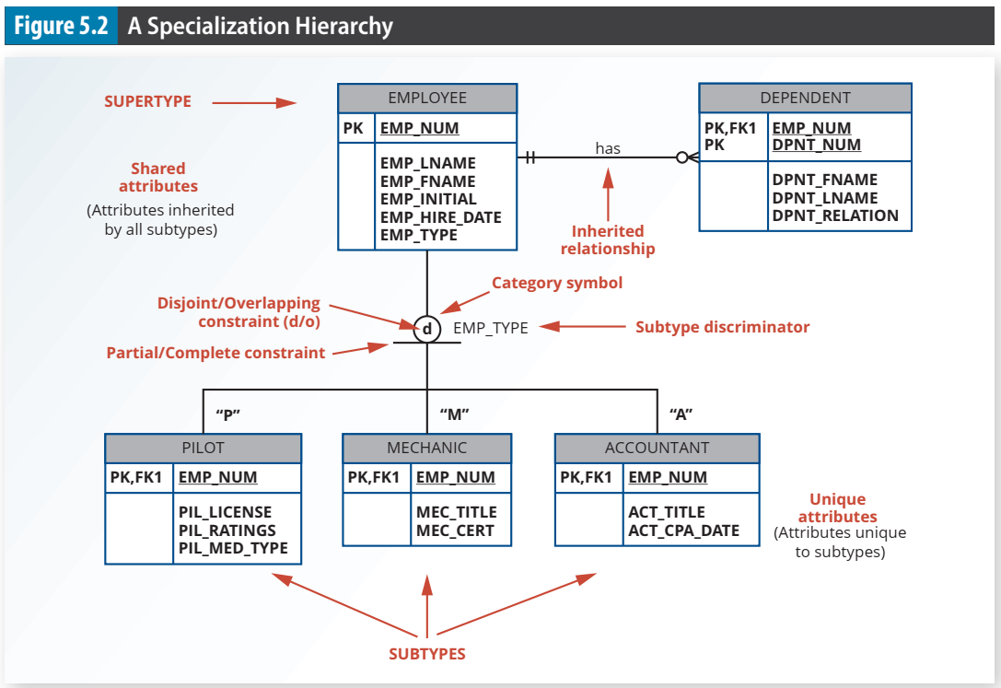

Slide 10
5-1c Inheritance
The property of inheritance enables an entity subtype to inherit the attributes and relationships of the supertype.
Entity subtypes inherit their primary key attribute from their supertype
Entity subtypes inherit all relationships in which the supertype entity participates

Slide 11
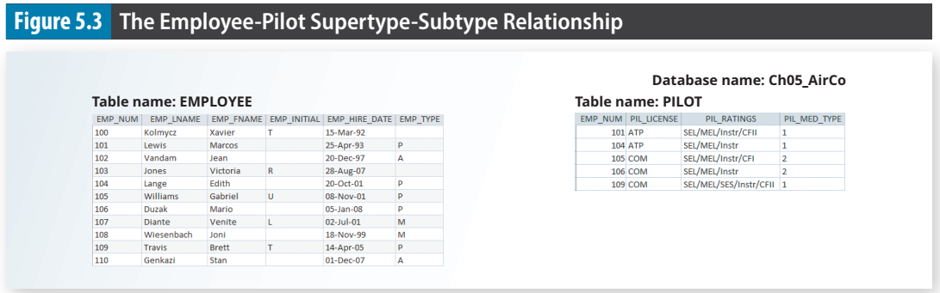
At the implementation level, the supertype and its subtype(s) depicted in the specialization hierarchy maintain a 1:1 relationship. For example, the specialization hierarchy lets you replace the undesirable EMPLOYEE table structure in Figure 5.1 with two tables—one representing the supertype EMPLOYEE and the other representing the subtype PILOT.

Slide 12
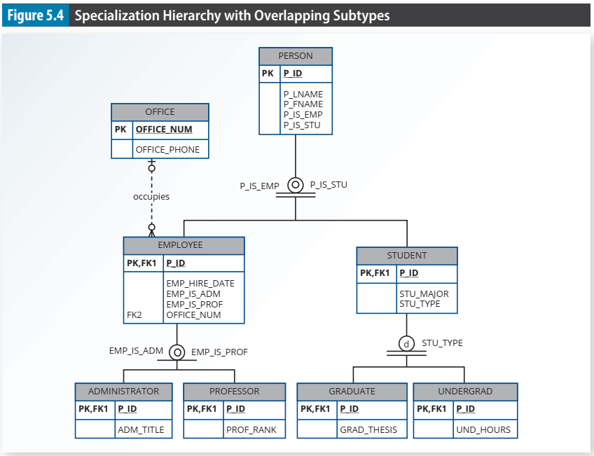

Slide 13
5-1d Subtype Discriminator
A subtype discriminator is the attribute in the supertype entity that determines to which subtype the supertype occurrence is related
The subtype discriminator is the employee type (EMP_TYPE)
the supertype is related to a PILOT subtype if the EMP_TYPE has a value of “P.” If the EMP_TYPE value is “M,” the supertype is related to a MECHANIC subtype. If the EMP_TYPE value is “A,” the supertype is related to the ACCOUNTANT subtype.

Slide 14
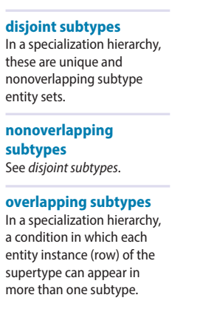
5-1e Disjoint and Overlapping Constraints
An entity supertype can have disjoint or overlapping entity subtypes
an employee can be a pilot, a mechanic, or an accountant
Disjoint subtypes, or nonoverlapping subtypes, are subtypes that contain a unique subset of the supertype entity set - each entity instance of the supertype can appear in only one of the subtypes
Employee cannot be pilot and accountant at the same time
Overlapping subtypes are subtypes that contain nonunique subsets of the supertype entity set; that is, each entity instance of the supertype may appear in more than one subtype

Slide 15
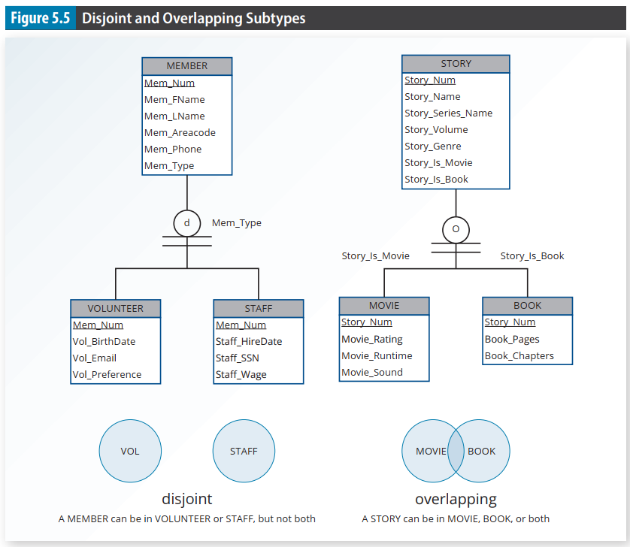

Slide 16
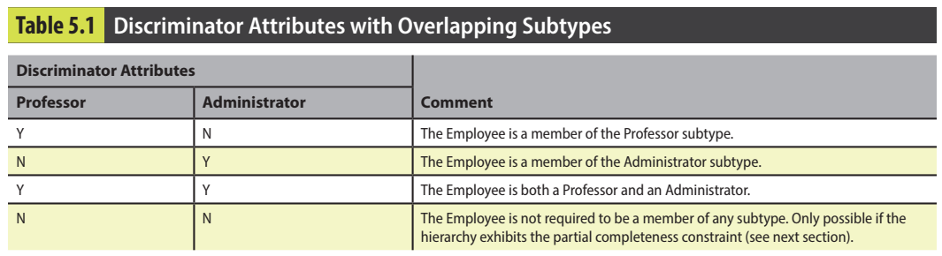

Slide 17
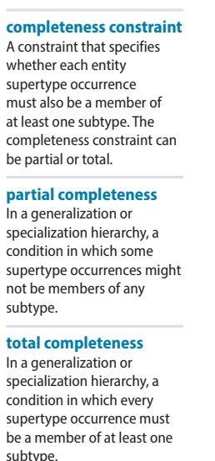
5-1f Completeness Constraint
The completeness constraint specifies whether each entity supertype occurrence must also be a member of at least one subtype.
Partial completeness means that not every supertype occurrence is a member of a subtype; some supertype occurrences may not be members of any subtype.
Total completeness means that every supertype occurrence must be a member of at least one subtype

Slide 18
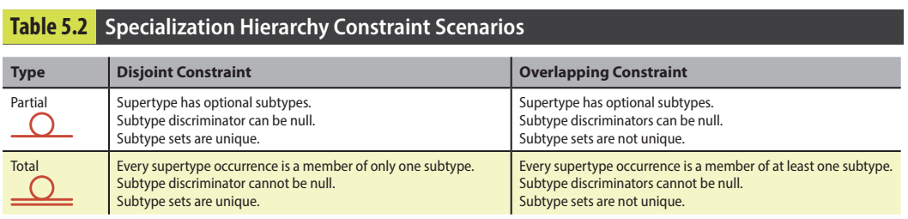

Slide 19
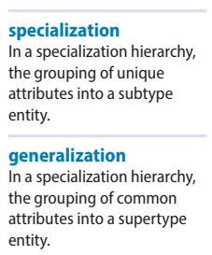
5-1g Specialization and Generalization
Various approaches to develop entity supertypes and subtypes.
Identify a regular entity and then identify all entity subtypes based on their distinguishing characteristics.
Identify multiple entity types and then later extract the common characteristics of those entities to create a higher-level supertype entity.
Specialization is the top-down process of identifying lower-level, more specific entity subtypes from a higher-level entity supertype
Generalization is the bottom-up process of identifying a higher-level, more generic entity supertype from lower-level entity subtypes

Slide 20
5-2 Entity Clustering

Slide 21
An entity cluster is a “virtual” entity type used to represent multiple entities and relationships in the ERD.
An entity cluster is formed by combining multiple interrelated entities into a single, abstract entity object.
it is a “conceptual” entity used to represent multiple entities and relationships, with the purpose of simplifying the ERD and thus enhancing its readability.
Tiny College Example:
OFFERING, which groups the SEMESTER, COURSE, and CLASS entities and relationships
LOCATION, which groups the ROOM and BUILDING entities and relationships

Slide 22
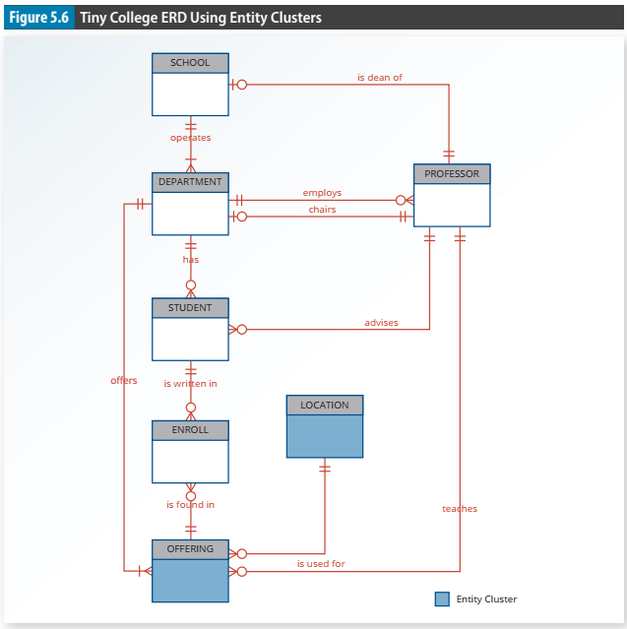

Slide 23
5-3 Entity Integrity: Selecting Primary Keys

Slide 24
5-3a Natural Keys and Primary Keys
A natural key or natural identifier is a real-world, generally accepted identifier used to distinguish—that is, uniquely identify—real-world objects.
As its name implies, a natural key is familiar to end users and forms part of their day-to-day business vocabulary.

Slide 25
5-3b Primary Key Guidelines
A primary key is the attribute or combination of attributes that uniquely identifies entity instances in an entity set.
Its main function is to uniquely identify an entity instance or row within a table
Second, primary keys and foreign keys are used to implement relationships among entities

Slide 26
5-3c When to Use Composite Primary Keys
As identifiers of composite entities, in which each primary key combination is allowed only once in the M:N relationship
As identifiers of weak entities, in which the weak entity has a strong identifying relationship with the parent entity

Slide 27
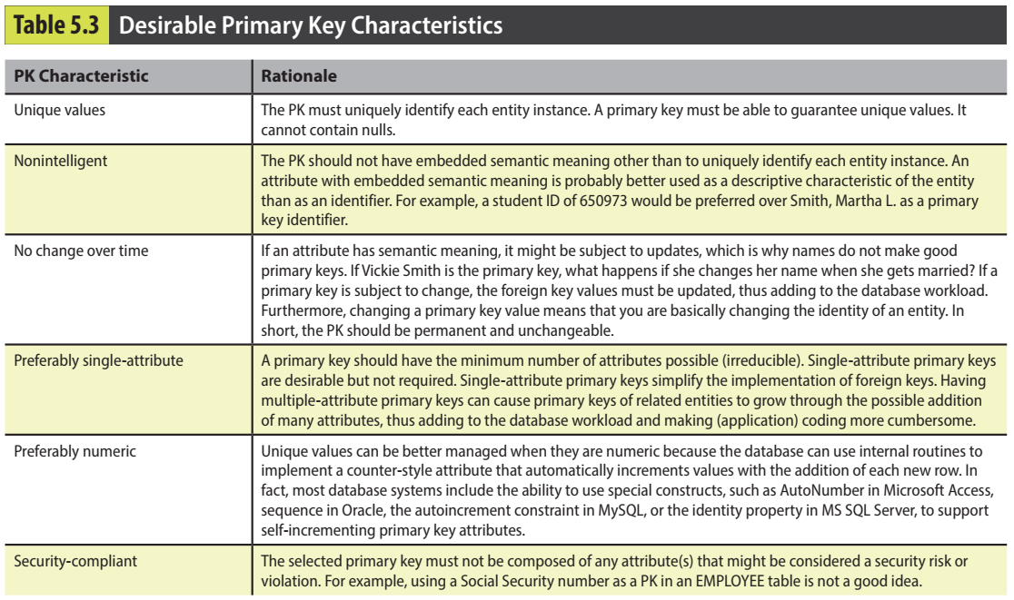

Slide 28
5-3d When to Use Surrogate Primary Keys
A surrogate key is a primary key created by the database designer to simplify the identification of entity instances.
A system-assigned primary key, generally numeric and auto-incremented

Slide 29
5-4 Design Cases: Learning Flexible Database Design

Slide 30
5-4a Design Case 1: Implementing 1:1 Relationships
1:1 relationship between EMPLOYEE and DEPARTMENT based on the business rule “one EMPLOYEE is the manager of one DEPARTMENT, and one DEPARTMENT is managed by one EMPLOYEE.”
Place a foreign key in both entities
Place a foreign key in one of the entities

Slide 31
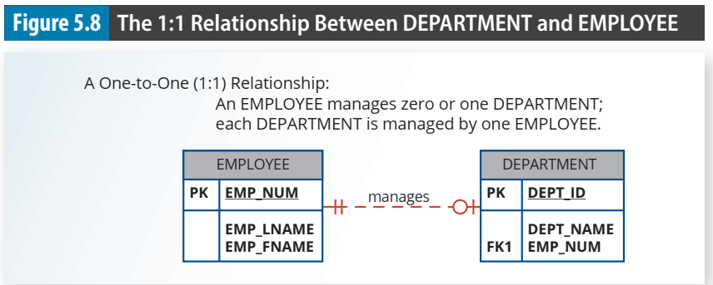

Slide 32
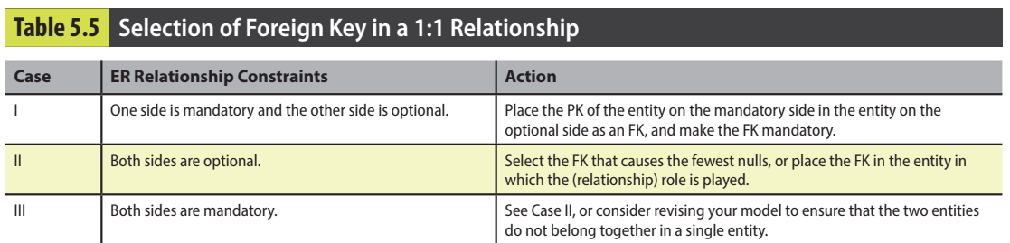

Slide 33
5-4b Design Case 2: Maintaining History of Time-Variant Data
time-variant data refers to data whose values change over time and for which you must keep a history of the data changes.
Some time-variant data is equivalent to having a multivalued attribute in your entity. To model this type of time-variant data, create a new entity in a 1:M relationship with the original entity.
This new entity will contain the new value, the date of the change, and any other attribute that is pertinent to the event being modeled
Other time-variant data can turn a 1:M relationship into an M:N relationship.
Your data model includes data about the different departments in the organization and which employee manages each department. Each department is managed by only one employee and each employee can manage one department at most, then a 1:1 relationship would exist between EMPLOYEE and DEPARTMENT.

Slide 34
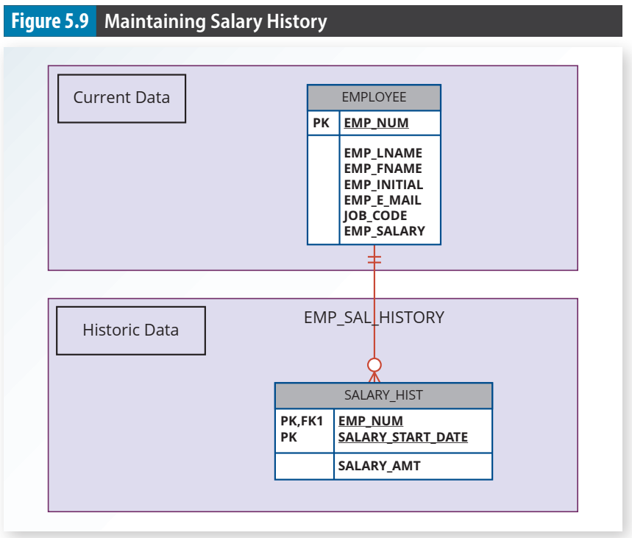

Slide 35
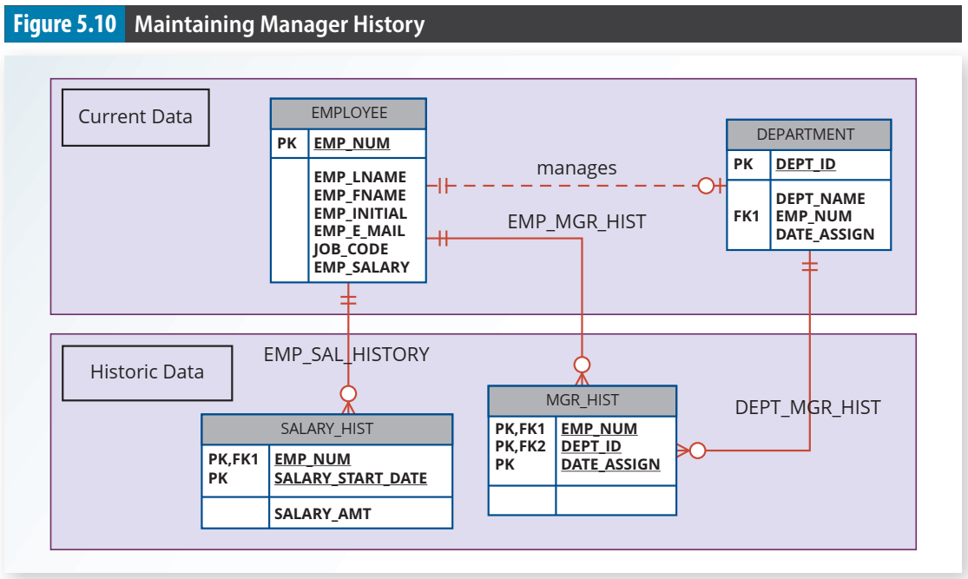

Slide 36
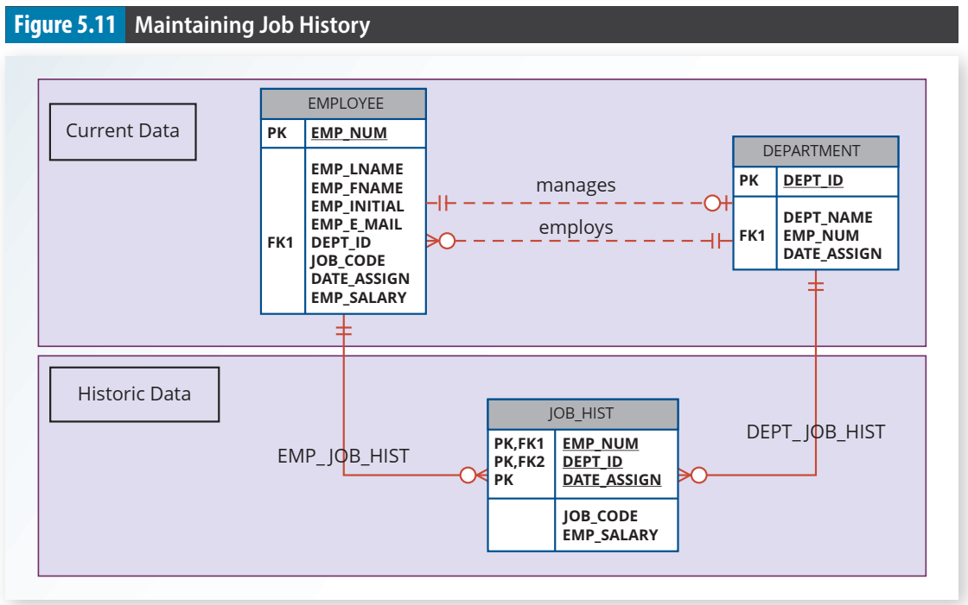

Slide 37
5-4c Design Case 3: Fan Traps
A design trap occurs when a relationship is improperly or incompletely identified and is, therefore, represented in a way that is not consistent with the real world.
A fan trap occurs when you have one entity in two 1:M relationships to other entities, thus producing an association among the other entities that is not expressed in the model.

Slide 38
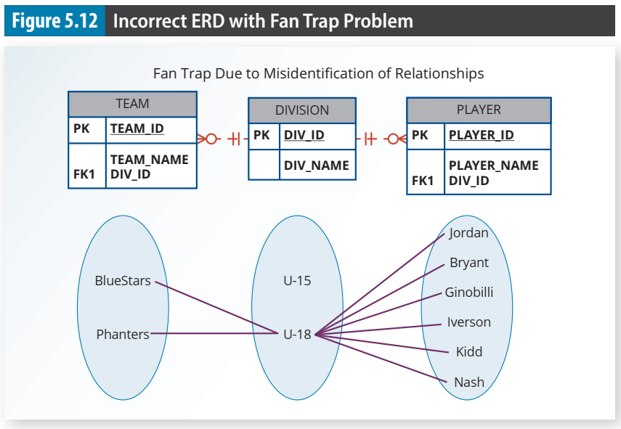
there is no way to
identify which players belong to which team.

Slide 39
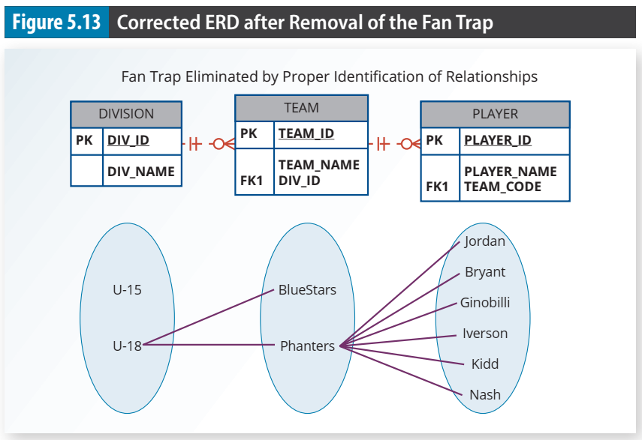

Slide 40
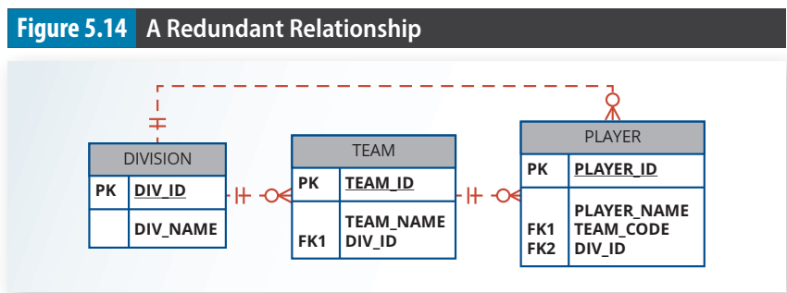
5-4d Design Case 4: Redundant Relationships
Redundant relationships occur when there are multiple relationship paths between related entities.
Transitive 1:M relationship between DIVISION and PLAYER through the TEAM entity set. Therefore, the relationship that connects DIVISION and PLAYER is redundant

Slide 41
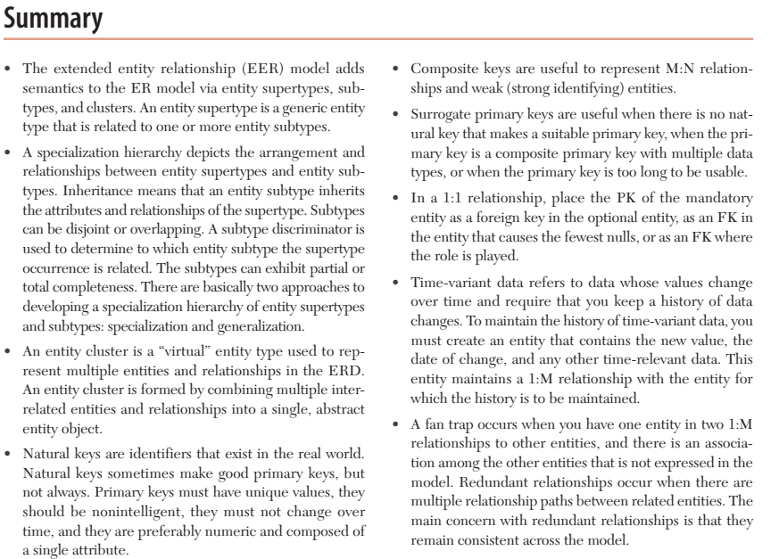

Slide 42
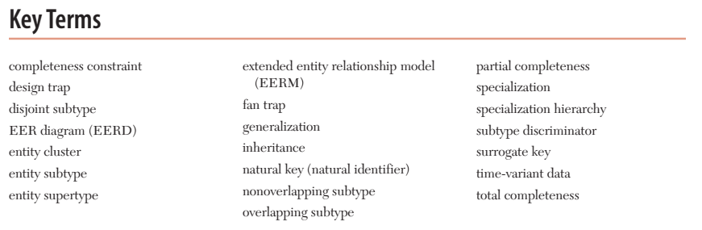

Slide 43
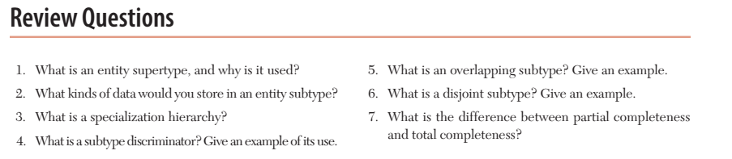

Slide 44
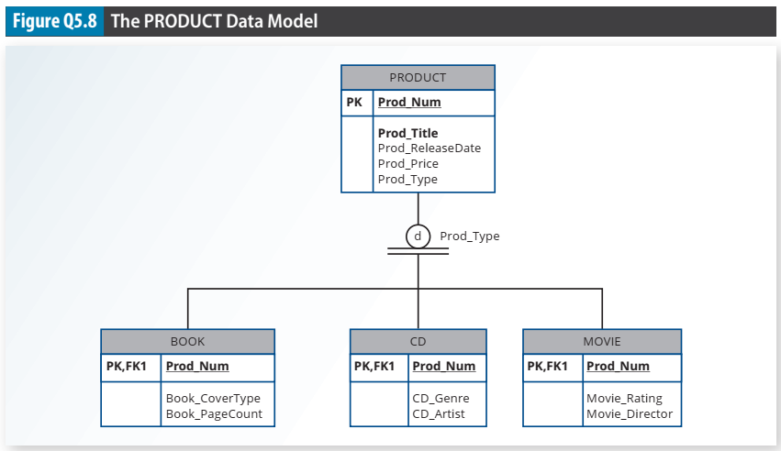

Slide 45
